Slide 1

Seattle Airbnb Price
Prediction
Karthik Garimella, Sandeep Alfred
MA 5790 - Fall 2024 - Team 12
‹#›

Slide 2
Goal of the Study
To Predict Prices of Airbnb Homestays in the city of Seattle.
Getting the data
Downloaded the latest quarterly listings of houses from Airbnb.
Added state and city names to the dataset whilst extracting the listing of each city.
Filtered the cities to Seattle to get our dataset.

Slide 3
About The Data
Number of observations: 6442
Response Variable: Price (per night of stay)
Predictor Count: 76
Predictor Type | Count
Continuous | 38
Categorical | 27
Boolean | 6
Date | 5

Slide 4
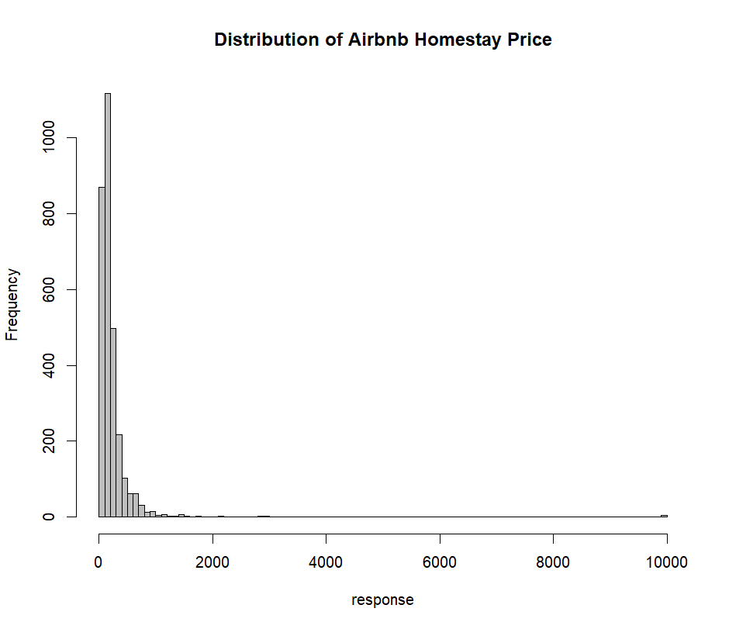
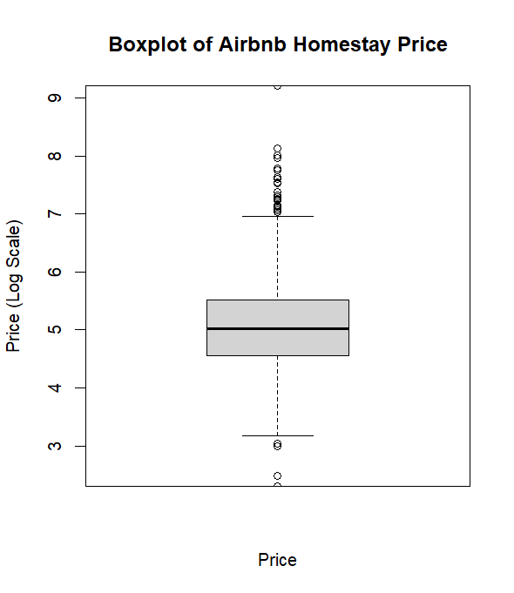
Response variable Diagnostics
The response variable is continuous and seems highly right skewed, there are also a decent number of outliers.

Slide 5
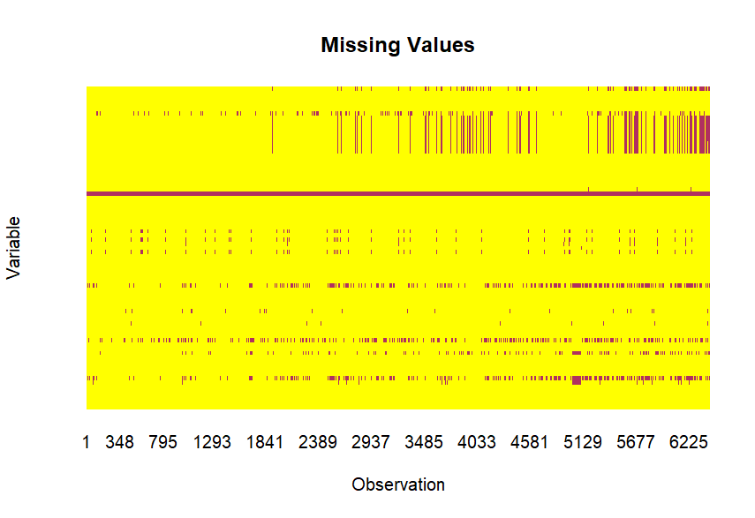
Preprocessing: Managing the Predictors
First eliminated the variables such as urls, description and the ones mostly containing null values and are repeated in different names, making the predictors drop from 76 to 28.
Removed rows with null values in the response variable.
Converted bedrooms, and all the month columns as categorical variables, and added the dummy variables, increasing predictors from 28 to 71.
KNN imputed all the remaining missing values.

Slide 6
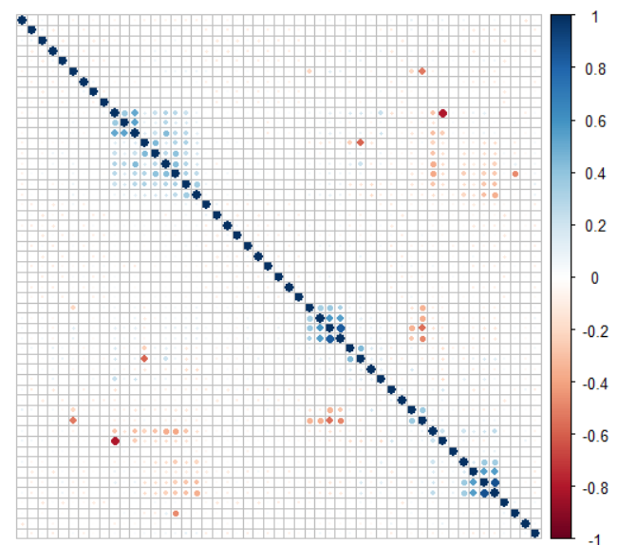
Preprocessing: Near Zero Variance and Highly Correlated
Eliminated the predictors with near zero variances, making the predictors drop from 71 to 51.
Eliminated the predictors with high correlations (>0.8), making the predictors drop from 51 to 48.
The dataset without the highly correlated predictors was only used with models which cannot handle highly correlated variables.

Slide 7
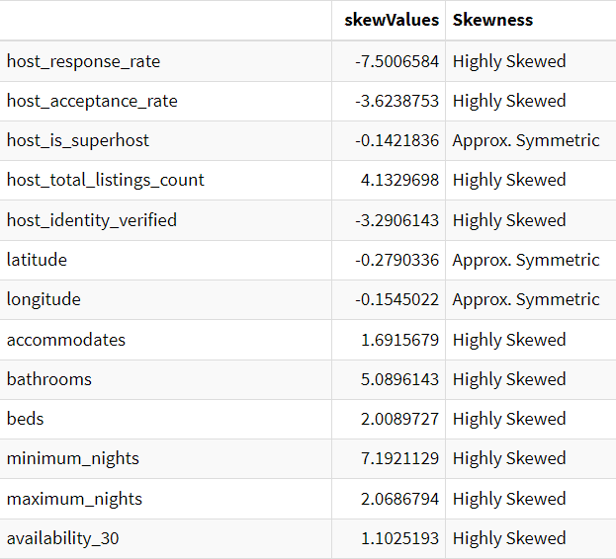
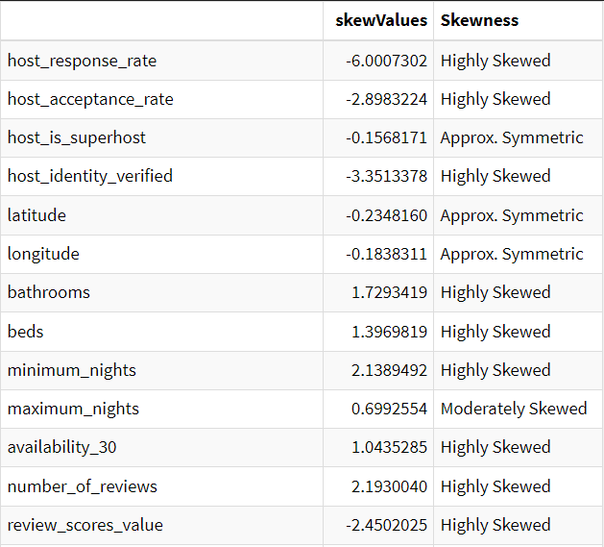
Preprocessing: Transformations
Centered and scaled the data.
Applied BoxCox transformation to improve the distributions of the predictors.
Applied spatial sign transformation to reduce the impact of outliers.

Slide 8
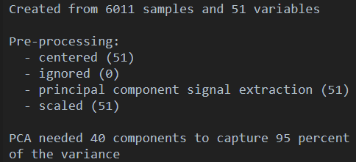
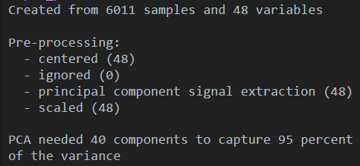
Principal Component Analysis
PCA suggests 40 components to capture 95% of the variance.
Dataset containing highly correlated variables
Dataset not containing highly correlated variables

Slide 9
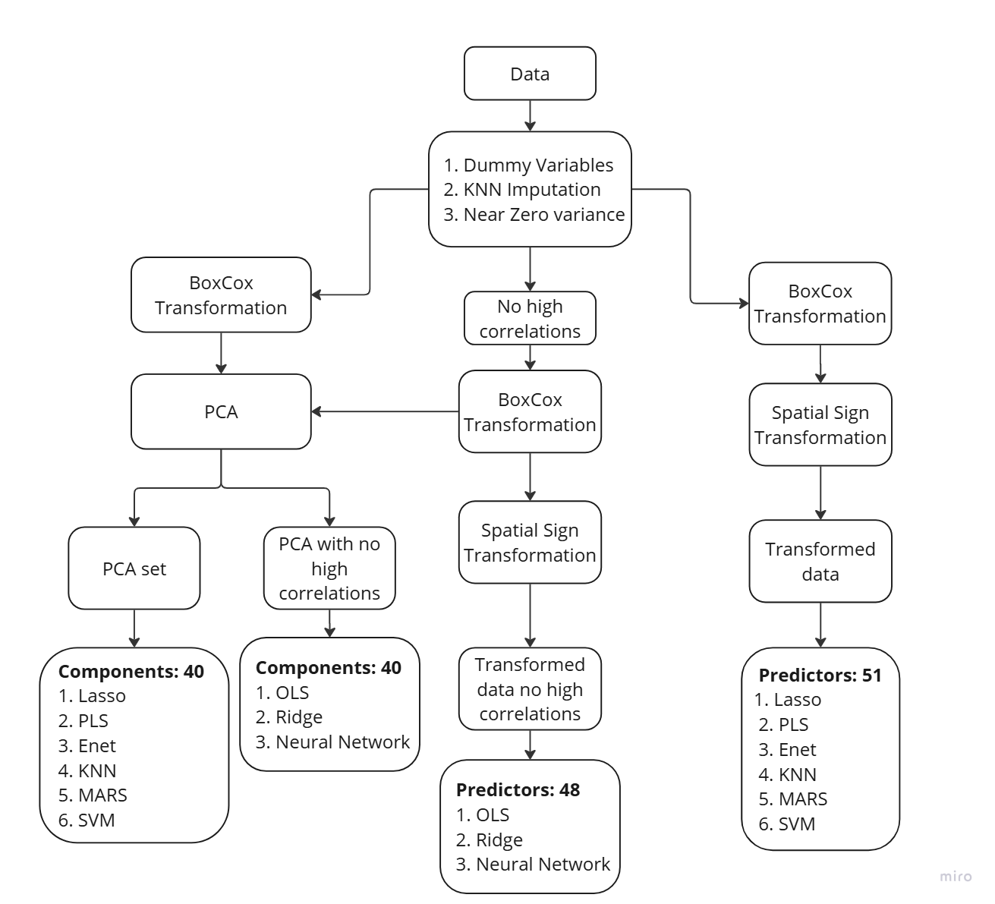
Modelling
Split the data into 80% Train and 20% Test sets.
Used 10 fold Cross-Validation resampling on all the models.
Used Rsquared as the metric to choose the best parameters.

Slide 10
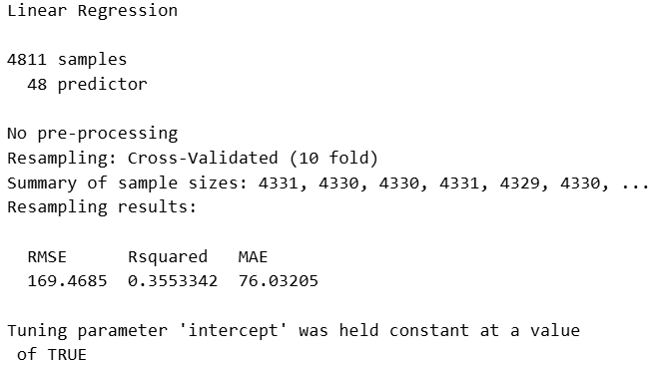
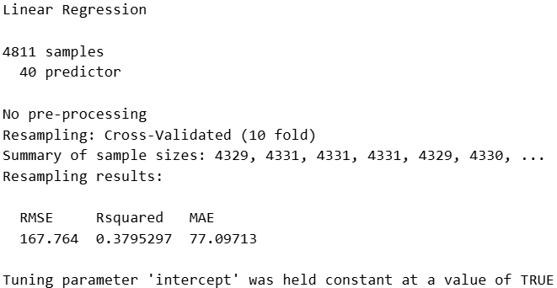
Linear Models: Ordinary Linear Regression
Transformed data:
PCA:

Slide 11
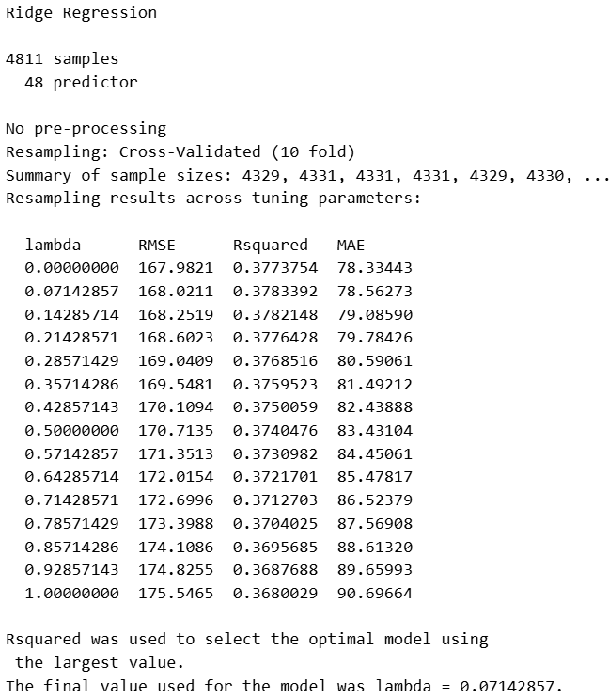
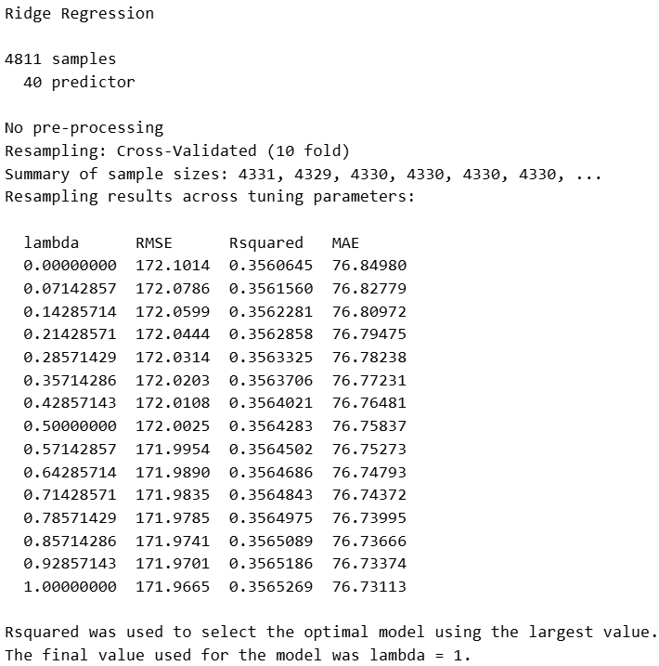
Linear Models: Ridge Regression
Transformed data:
PCA:

Slide 12
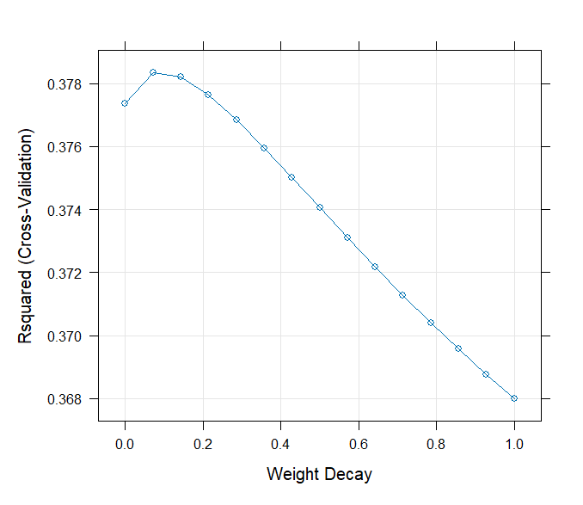
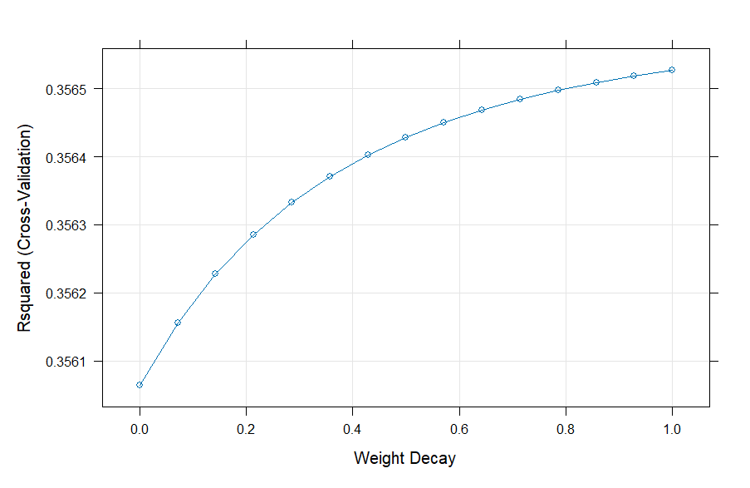
Ridge Regression Tuning Parameter plot
Transformed data:
PCA:

Slide 13
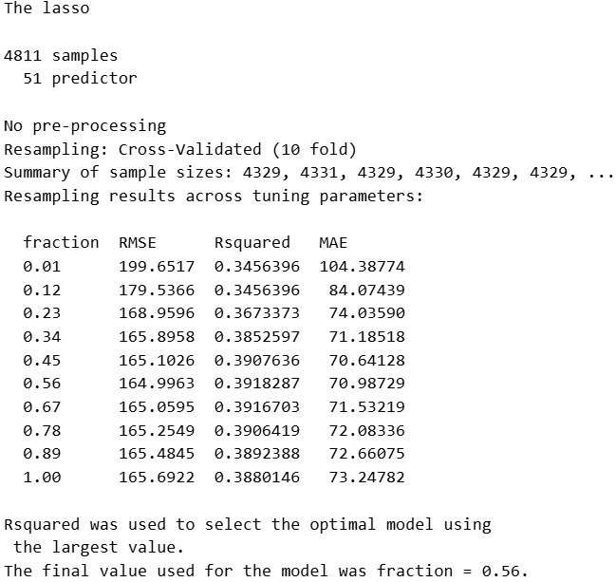
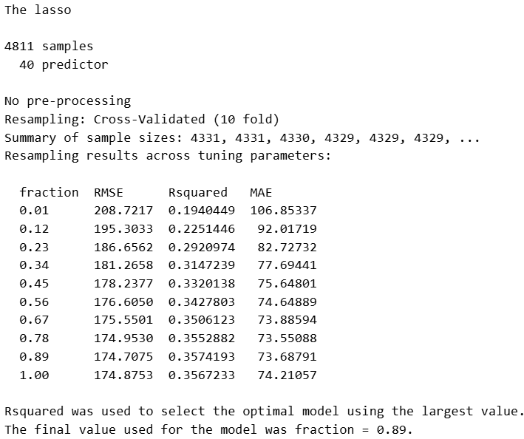
Linear Models: Lasso Regression
Transformed data:
PCA:

Slide 14
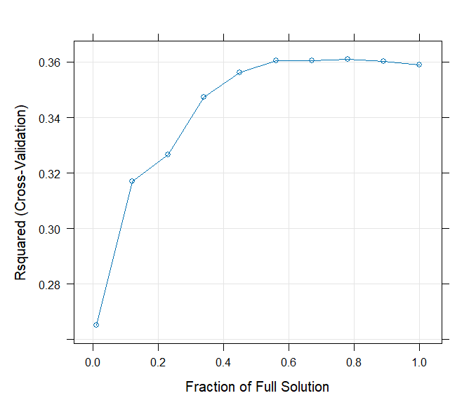
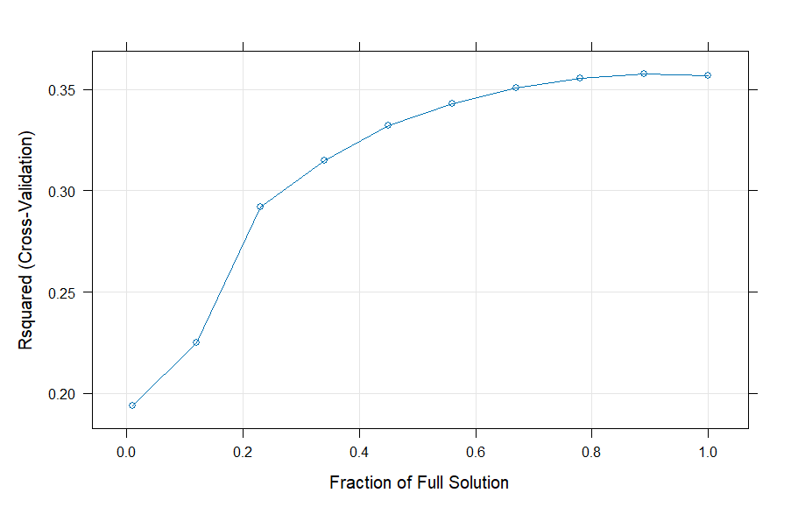
Lasso Regression Tuning Parameter plot
Transformed data:
PCA:

Slide 15
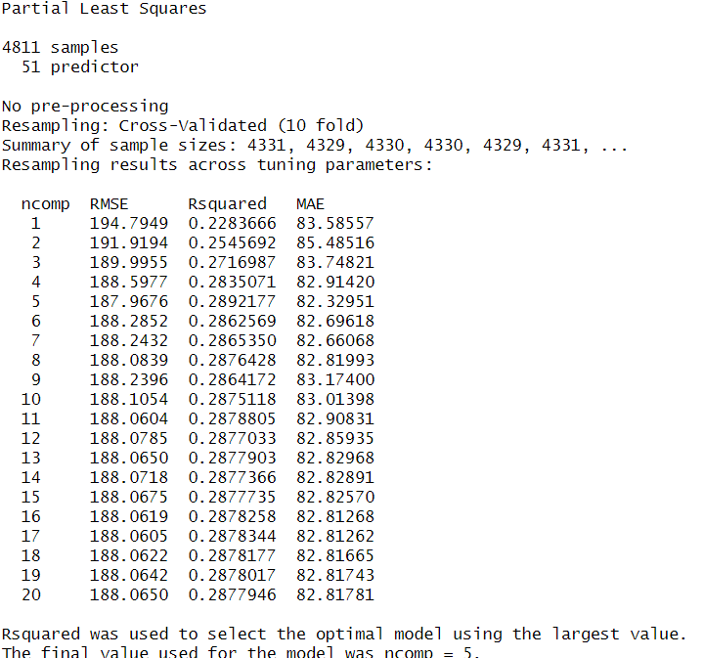
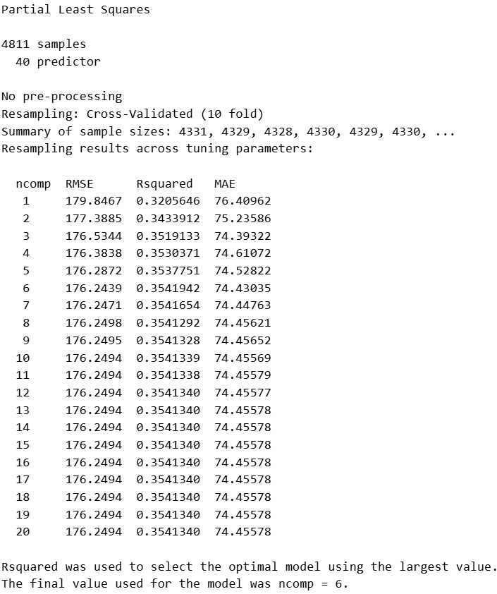
Linear Models: PLS
Transformed data:
PCA:

Slide 16
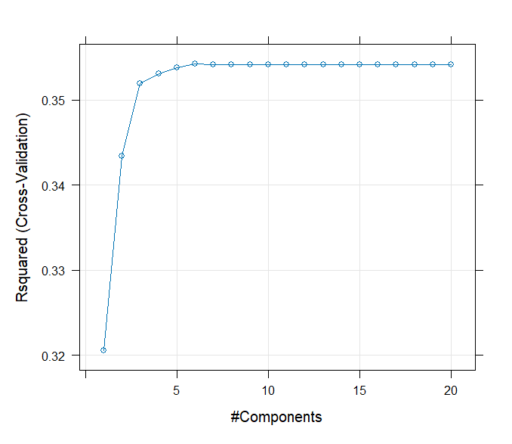
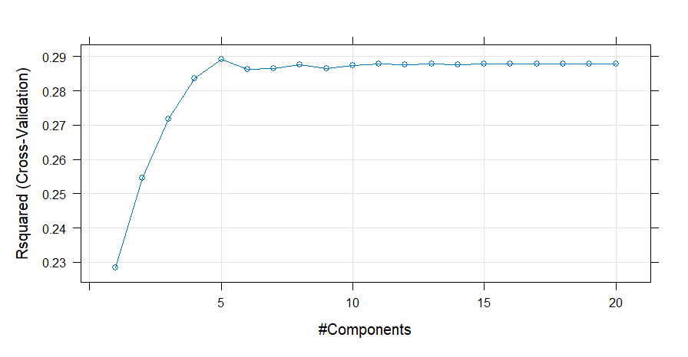
PLS Tuning Parameter plot
Transformed data:
PCA:

Slide 17
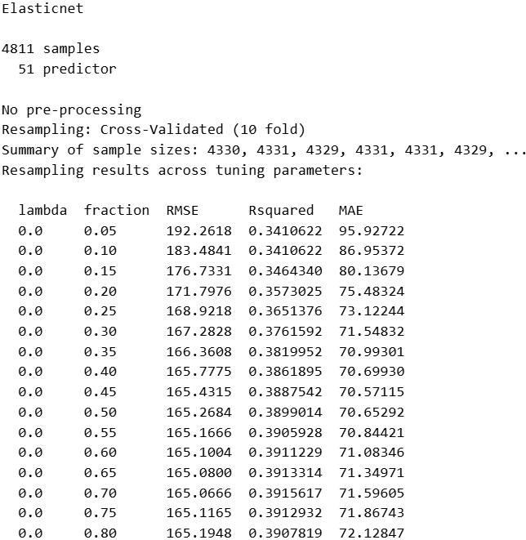
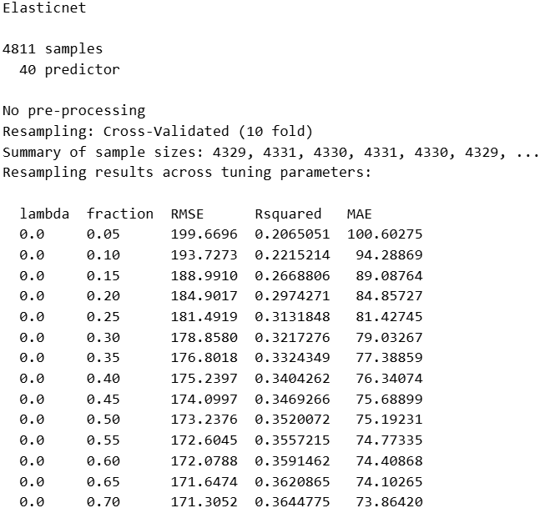
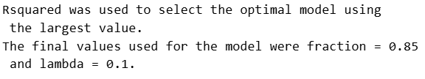
Linear Models: ENet
Transformed data:
PCA:

Slide 18
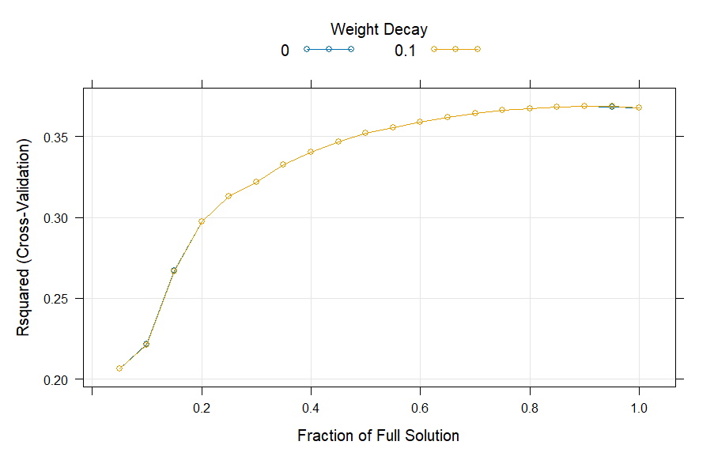
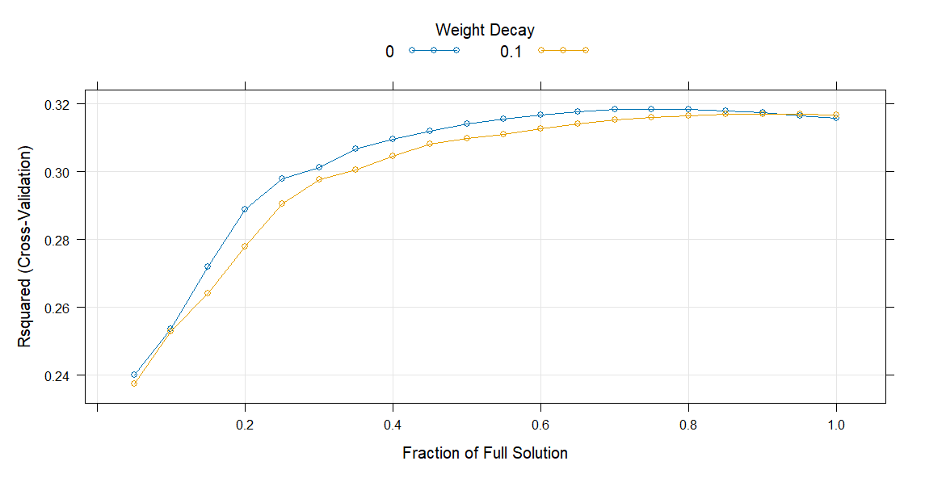
ENet Tuning Parameter plot
Transformed data:
PCA:

Slide 19
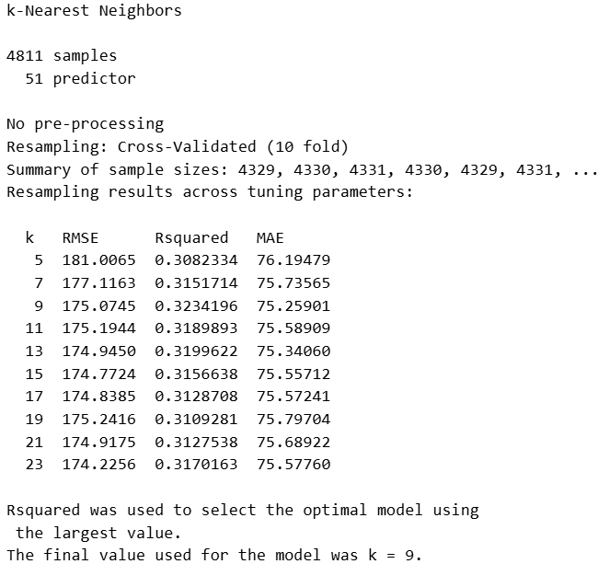
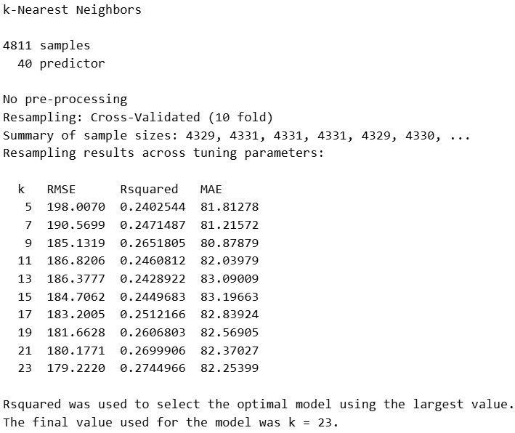
Non-Linear Models: KNN
Transformed data:
PCA:

Slide 20
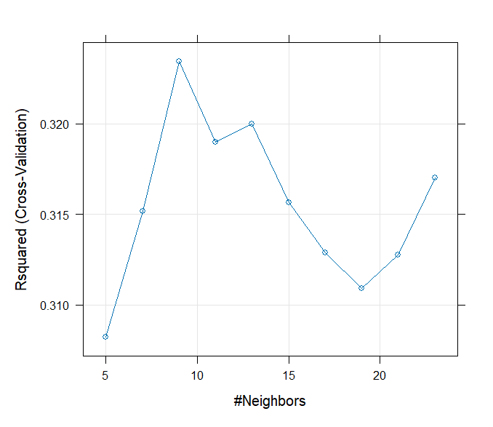
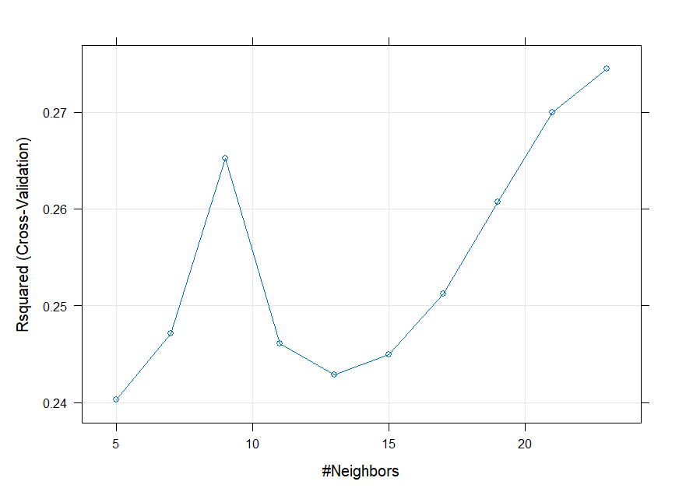
KNN Tuning Parameter plot
Transformed data:
PCA:

Slide 21
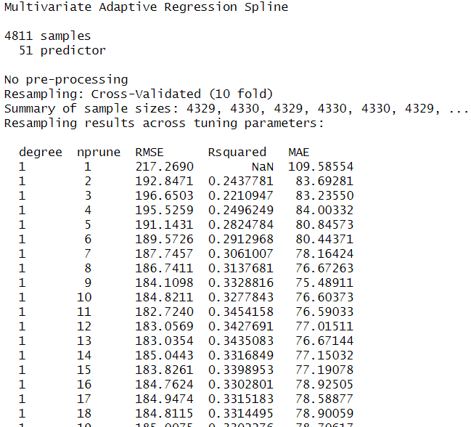
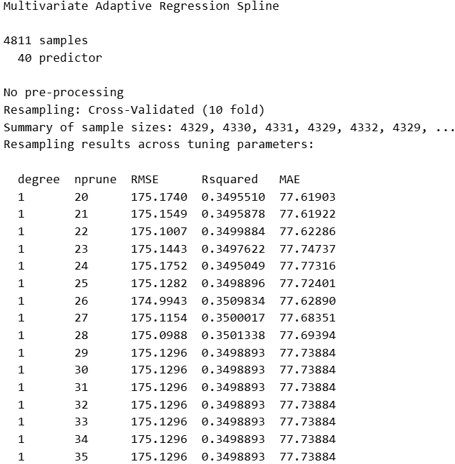
Non-Linear Models: MARS
Transformed data:
PCA:

Slide 22
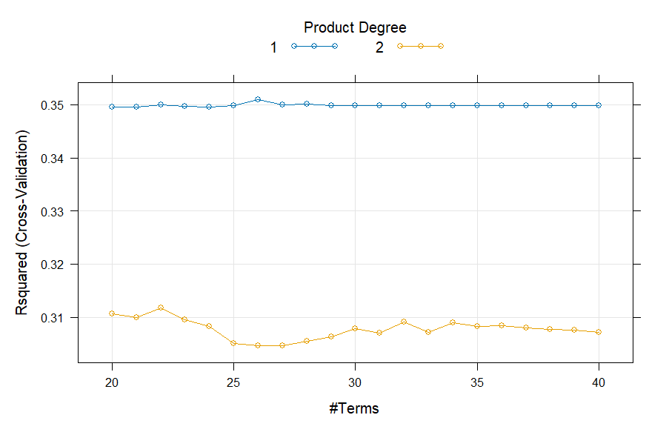
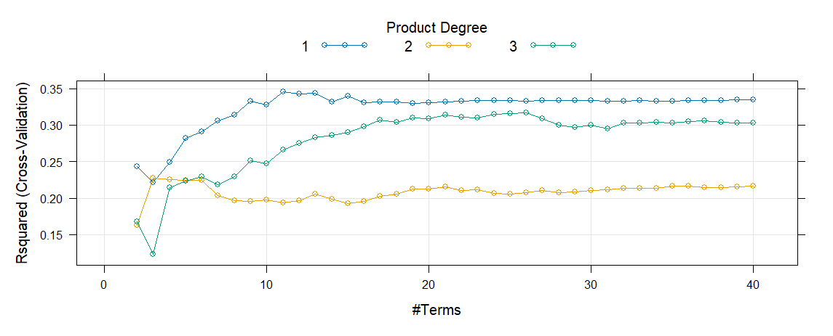
MARS Tuning Parameter plot
Transformed data:
PCA:

Slide 23
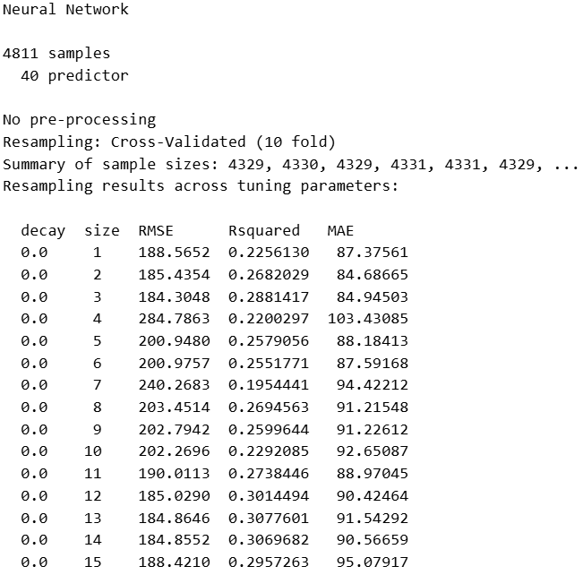
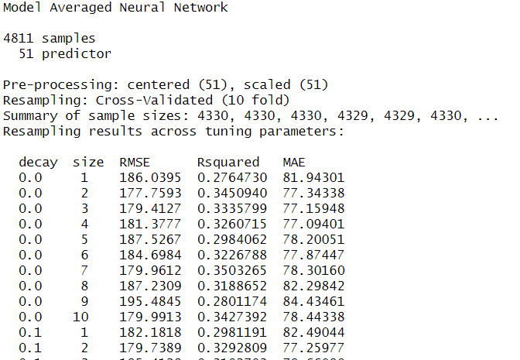
Non-Linear Models: Neural Networks
Transformed data:
PCA:

Slide 24
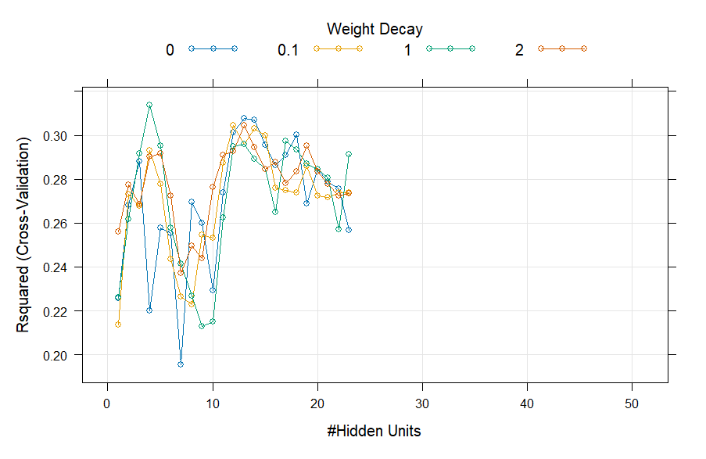
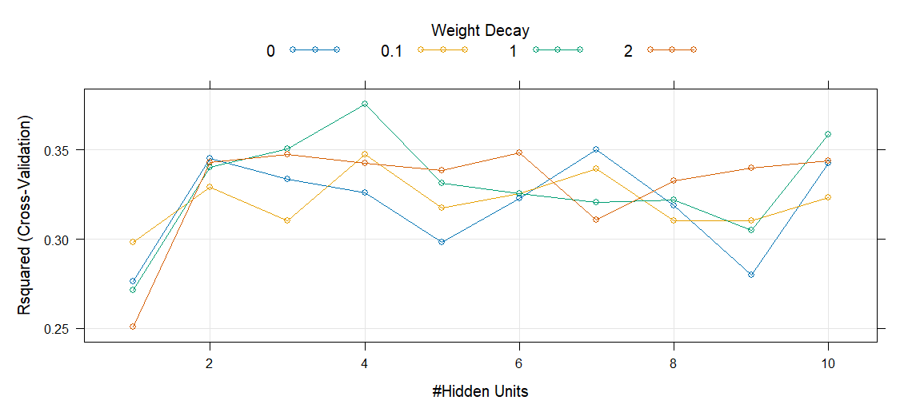
Neural Networks Tuning Parameter plot
Transformed data:
PCA:

Slide 25
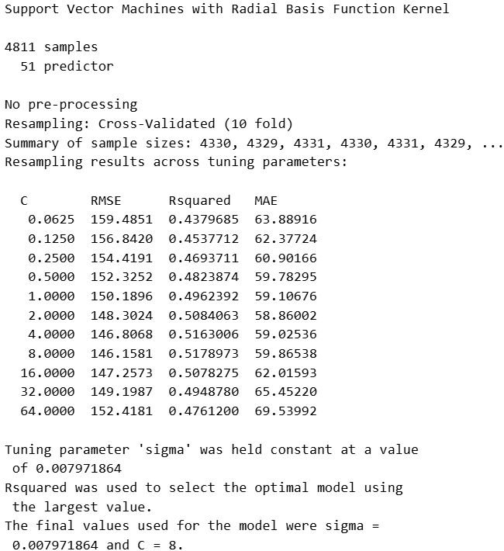
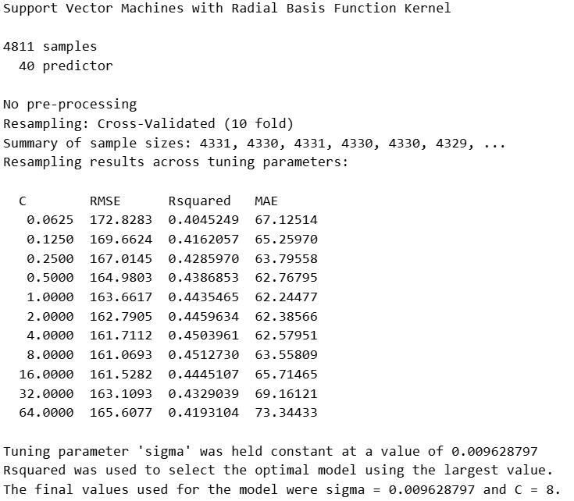
Non-Linear Models: SVM
Transformed data:
PCA:

Slide 26
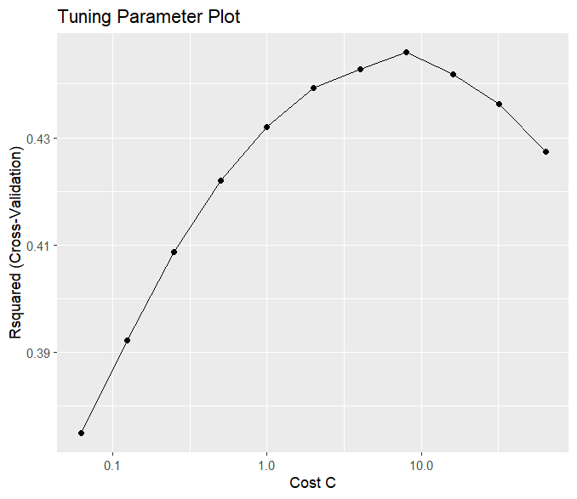
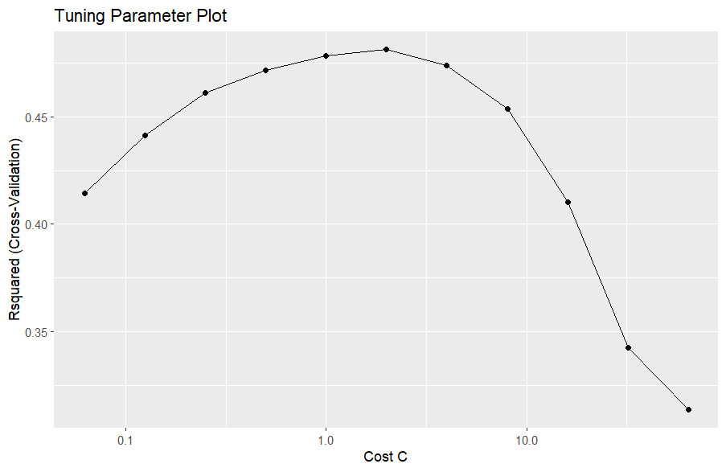
SVM Tuning Parameter plot
Transformed data:
PCA:

Slide 27
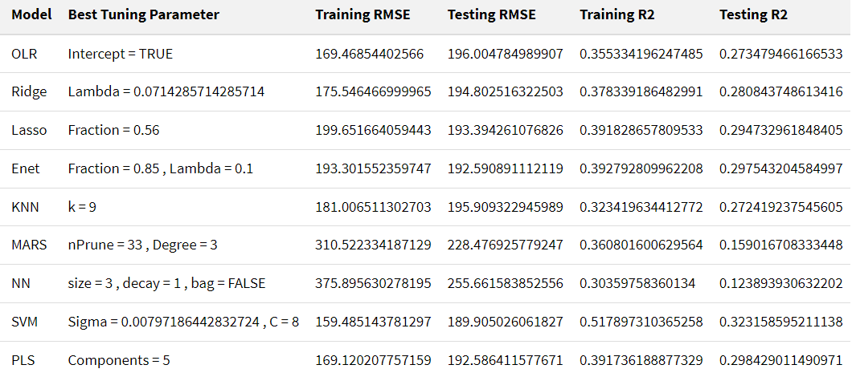
Transformed Data Summary

Slide 28
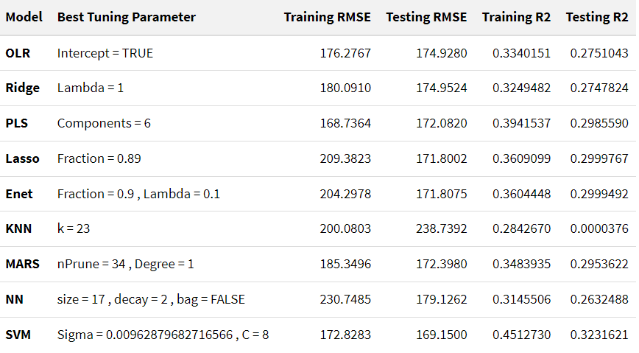
PCA Summary

Slide 29
Results
Both the datasets did not perform well with the models, this could be due to underlying factors such as the dataset not having the necessary predictors which are required by the response.
There were no significant differences in transformed data vs PCA, the transformed data slightly performed better.
The top two models that performed well on training set are SVM with transformed data and SVM with PCA.

Slide 30
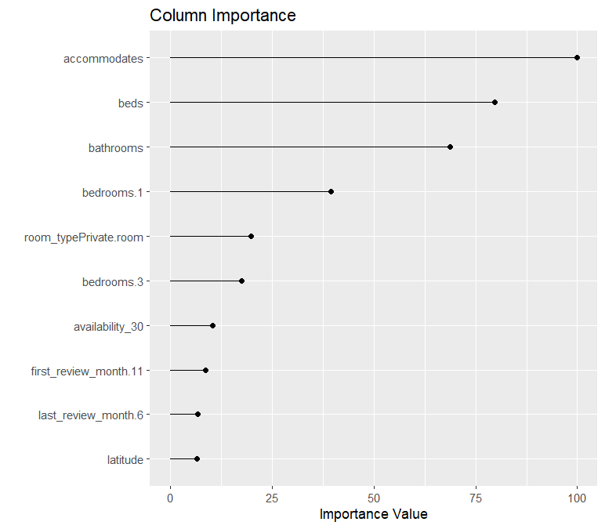
Important predictors for the best model
The best model is SVM with Sigma = 0.00797186442832724 and C = 8 .

Slide 31
Thank you,
Let us know any questions you have!
Karthik Garimella, Sandeep Alfred
MA 5790 - Fall 2024 - Team 12

